Slide 1

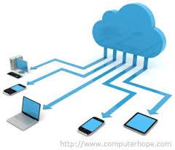
Cloud Computing using Intranet
Presented By :
Utkarsh Kore (10)
Niraj Palkar (14)
Harsh Tarkar(15)
Omkar Dongre (22)
Guided By:
Mrs .Poonam Wavare

Slide 2
ARCHITECHTURE
Cloud

Slide 3
MODULES INCLUDED
Authentication(Log-In) Module
Chat Module
File transfer module
Log Files Module
Packet filter Module
Encryption & Decryption Module
Screenshots

Slide 4
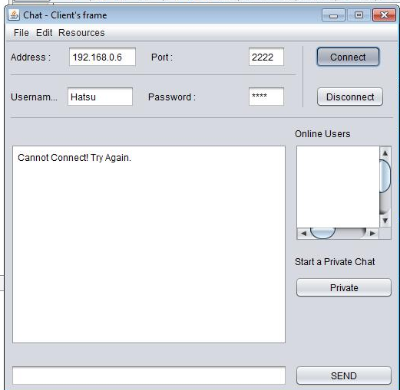
AUTHENTICATION MODULE
This module enforces the client to get logged in with valid client ID and password.
Client has to pass through this process each time when he wants to perform some tasks using this software.

Slide 5
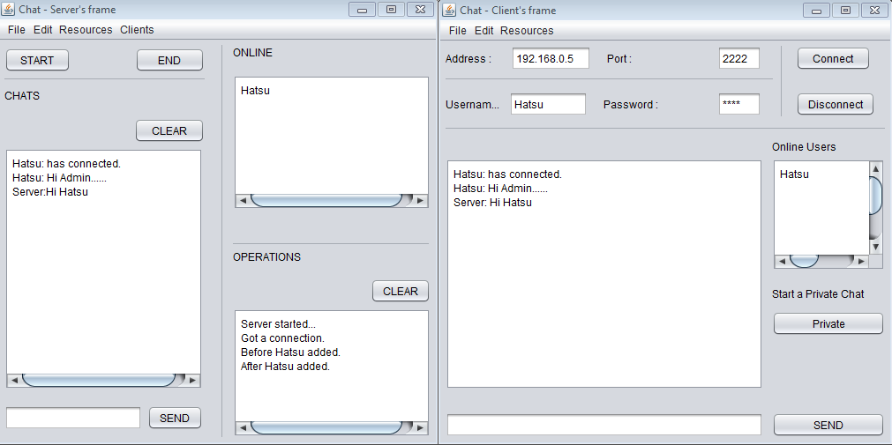
CHAT MODULE
In this module, clients are able to communicate with each other.
Clients can send message to server also get response from it.
Server has rights to break communication with specific client by disconnection connections from client.

Slide 6
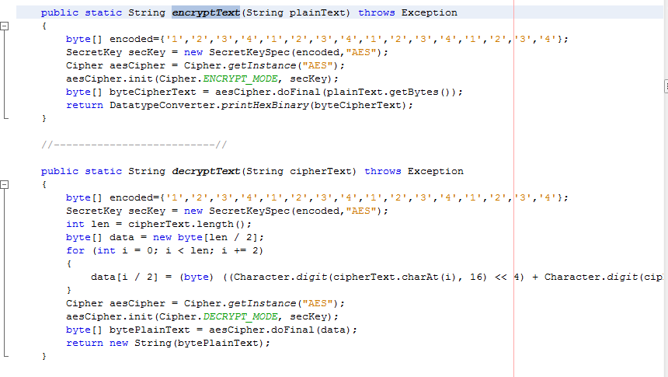
ENCRYPTION & DECRYPTION MODULE
The software uses AES(Advaced Encryption Starndard) for encryption.
Data shared from client to server and server to client is proper encrypted and decrypted using this algorithm.

Slide 7
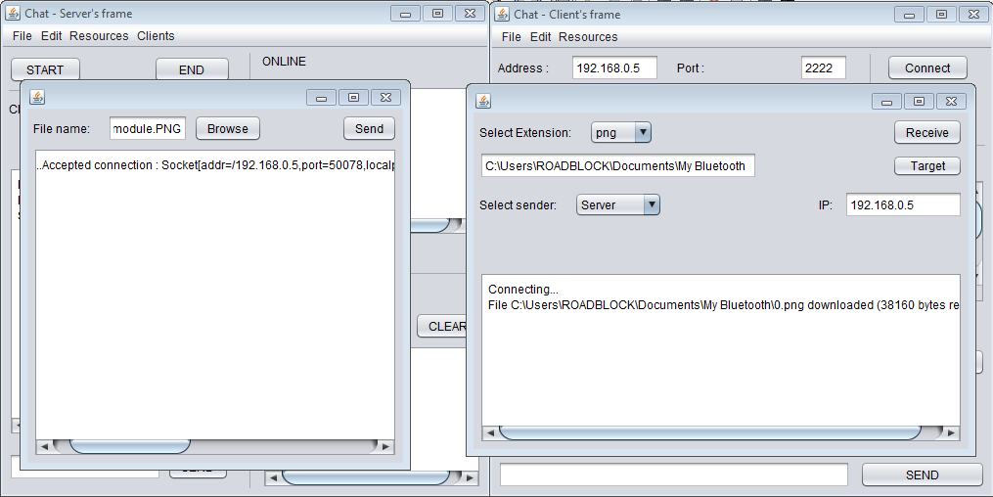
FILE TRANSFER MODULE
This module handles Various types of file sharing between client and server.
Files to be shared must be selected from dialogue box with extension.
The file limit to shared is 100MB.

Slide 8
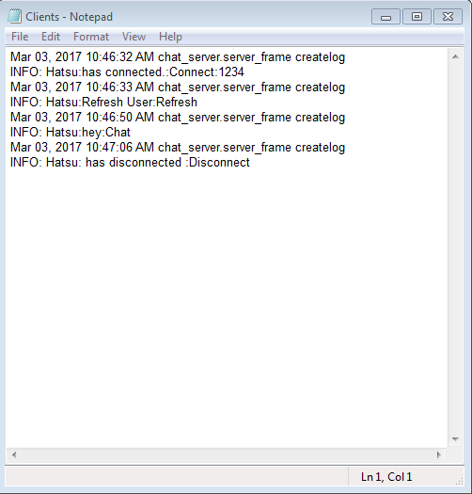
LOG FILE MODULES
This module maintains log data in the folder D:\CloudServer\serverlogs.
All the activities of the clients are recorded and saved as log using this module.
It stores the data like clients ID's, log in time, shared files etc.

Slide 9
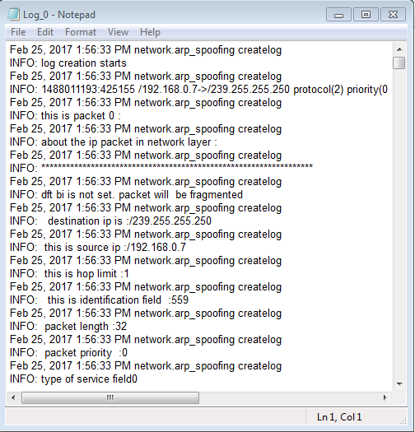
PACKET FILTER MODULE
Packet filter is a code that reads each packet as it passes between client and server and either blocks or forwards the packet based on settings.
Packet filtering is done on protocols such as TCP, UDP, IPv4, chaos etc.

Slide 10
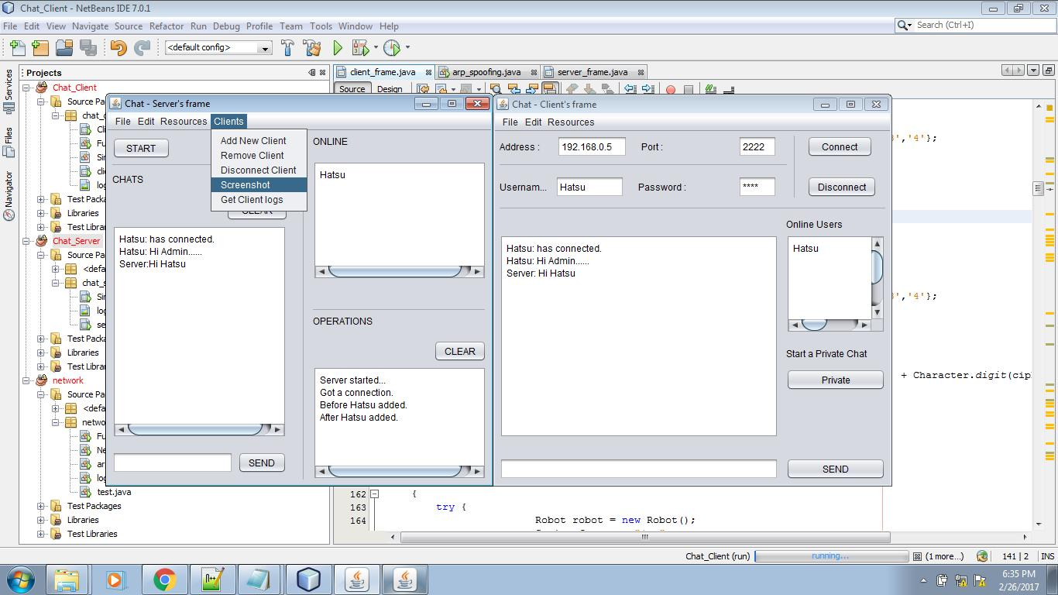
SCREENSHOT MODULE
It takes screen shots on the client's side screen after certain time.
These screenshots are stored in log folders and sent to the server verifying it.

